Slide 1
SANDLER x SALONE 2024

Slide 2
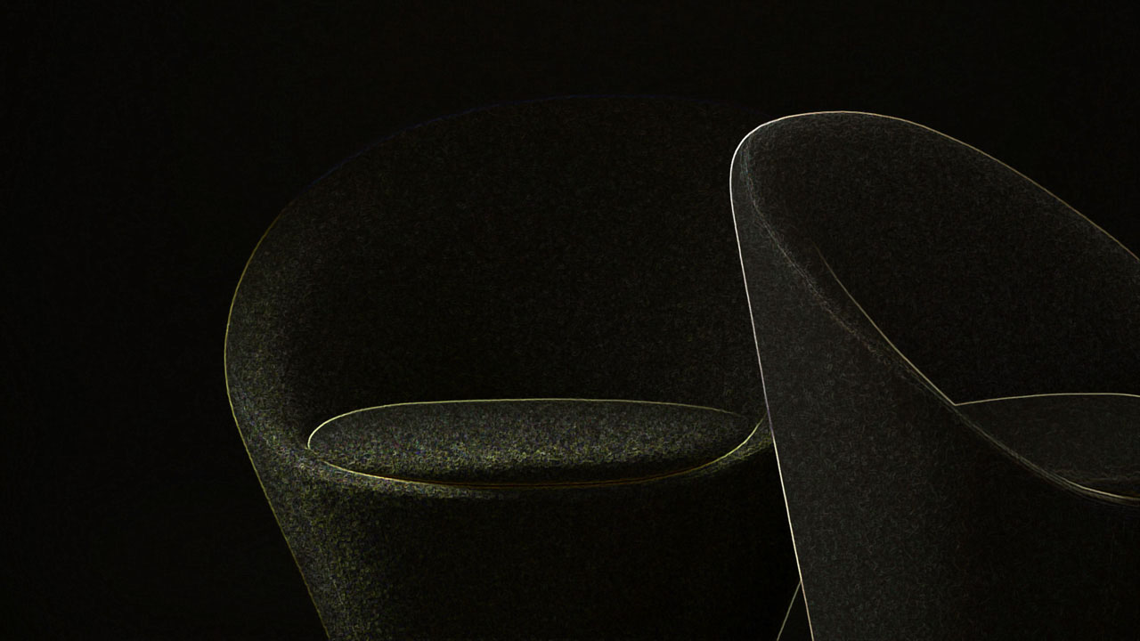
WABAO + INCLASS
Design - Florent Coirier

Slide 3
Notes:
Designed by Florent Coirier, the WABAO collection is born from the pursuit of refinament and beauty. The collection is a synthesis of organic design, timeless elegance, and functionality. Comprising four elements: lounge armchair, armchair, pouf, and side table, this collection combines elegance with sustainability and functionality. Its smooth, enveloping, and organic lines radiate warmth and harmony while providing a welcoming comfort.

Slide 4
Notes:
Lounge – 2140 List
Armchair – 1830 List
Upholstered lounge + armchair with an inner shell made of rotomoulded polyethylene covered with polyurethane foam and soft fiber. The seat is made with an inner plywood covered with moulded polyurethane foam with a density of 50 kg and soft fiber.
Difference between the armchair and lounge:
Armchair: seat depth: 17” overall w: 23”
Lounge: seat depth: 20” overall w: 33”

Slide 5
Notes:
Lounge – 2140 List
Armchair – 1830 List
Upholstered lounge + armchair with an inner shell made of rotomoulded polyethylene covered with polyurethane foam and soft fiber. The seat is made with an inner plywood covered with moulded polyurethane foam with a density of 50 kg and soft fiber.
Difference between the armchair and lounge:
Armchair: seat depth: 17” overall w: 23”
Lounge: seat depth: 20” overall w: 33”

Slide 8
Notes:
Low table sizes: 20” and 25”w both are 14.5” H

Slide 9
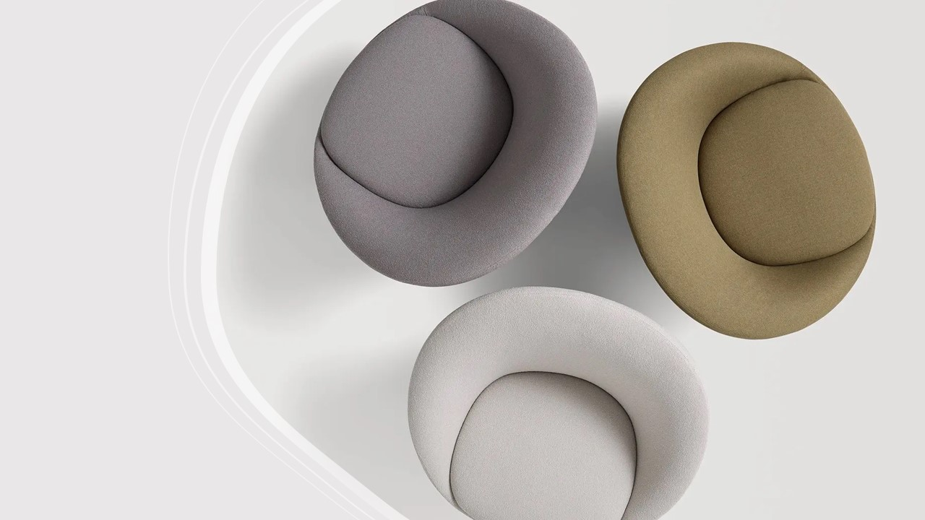

Slide 10
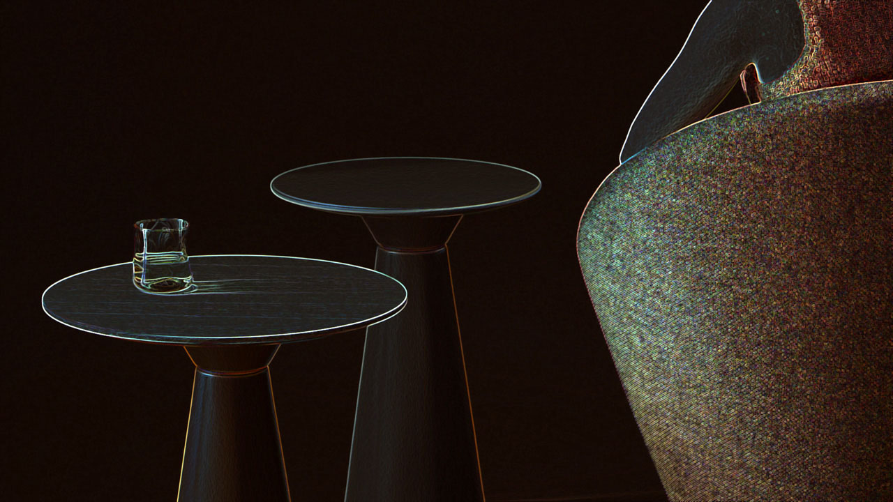
ESSENS OCCASIONAL + INCLASS
DESIGN – JONATHAN PRESTWICH

Slide 11
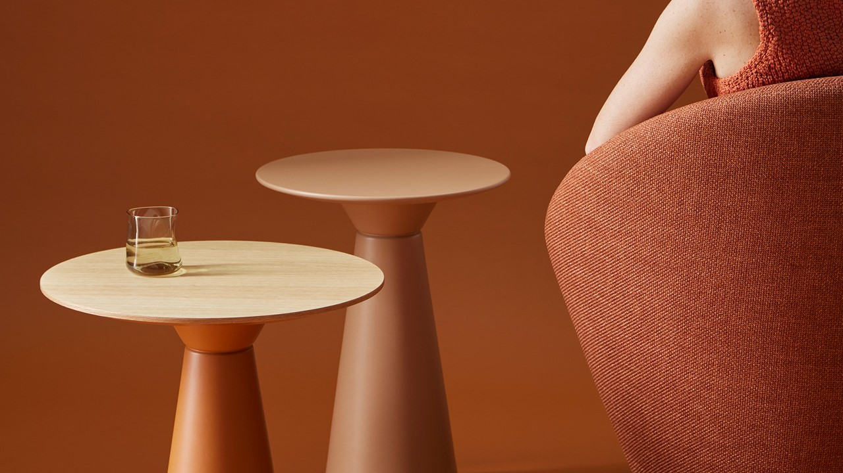
Notes:
Designed by Jonathan Prestwich, the ESSENS collection expands with the addition of side tables. The ESSENS OCCASIONAL side tables combine beauty, versatility, and harmonious proportions. The sculptural base is created from the encounter of two essential volumes in balance. The new ESSENS OCCASIONAL table program consists of three bases made of 100% recyclable polyethylene, allowing for the composition of both coffee and side tables with tops of various materials and sizes. The numerous possibilities for combining bases and tabletops, along with the extensive range of materials and finishes available, allow for endless customization to easily integrate into diverse spaces and contexts.

Slide 12
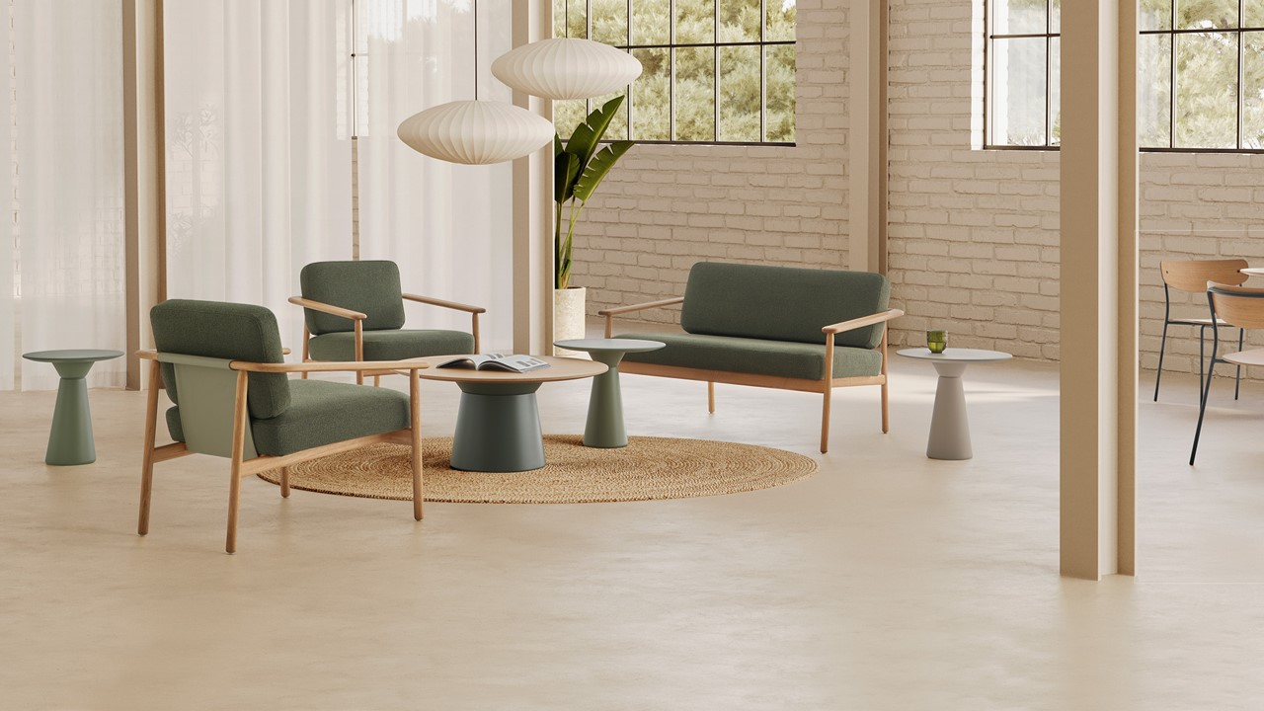

Slide 13
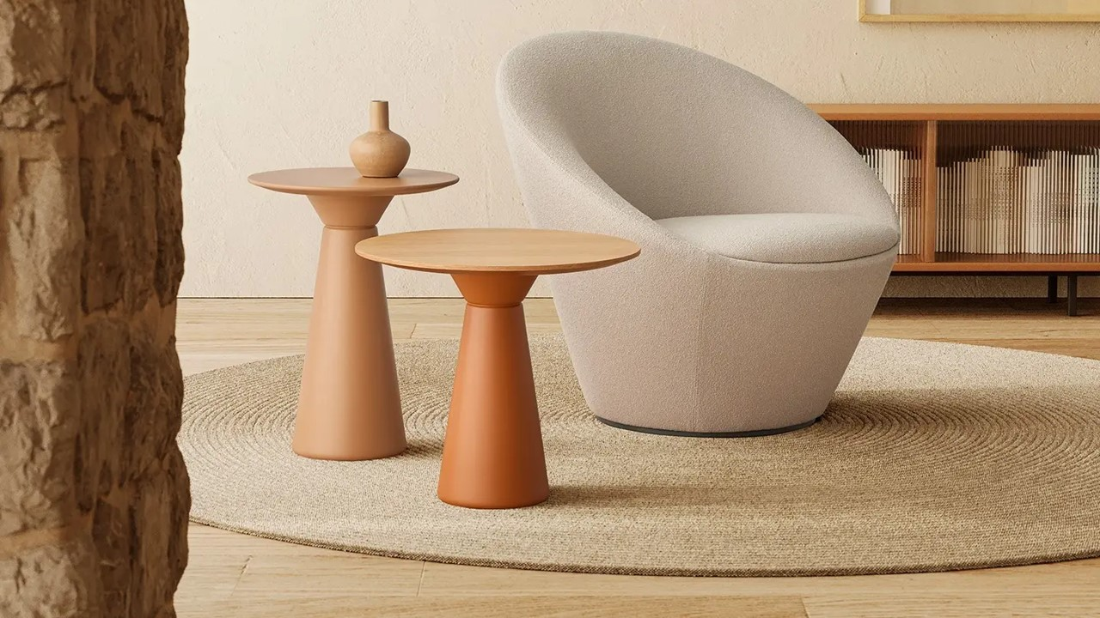

Slide 14
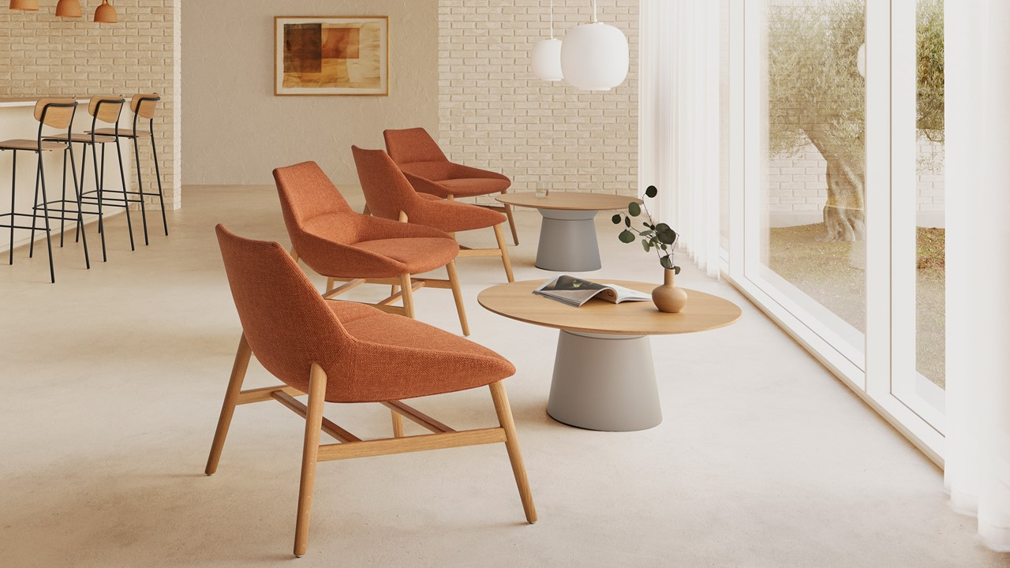

Slide 15
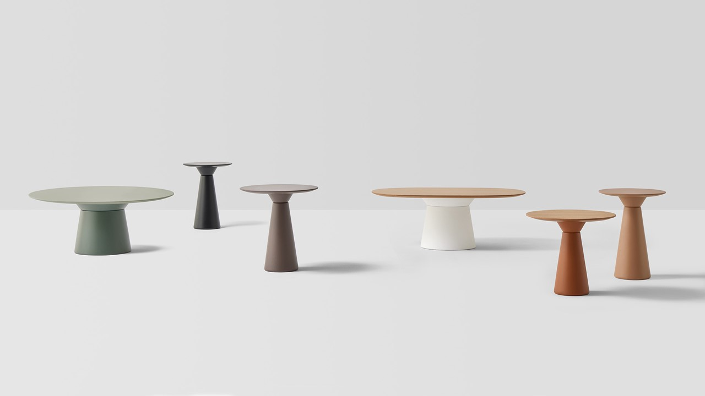
Notes:
Base types –
Occasional height 15”
Tops: 31”, 35”, 39” 43”
Bar/ Counter:
17”H
20”H
Tops 15”H, 19.5”H

Slide 16
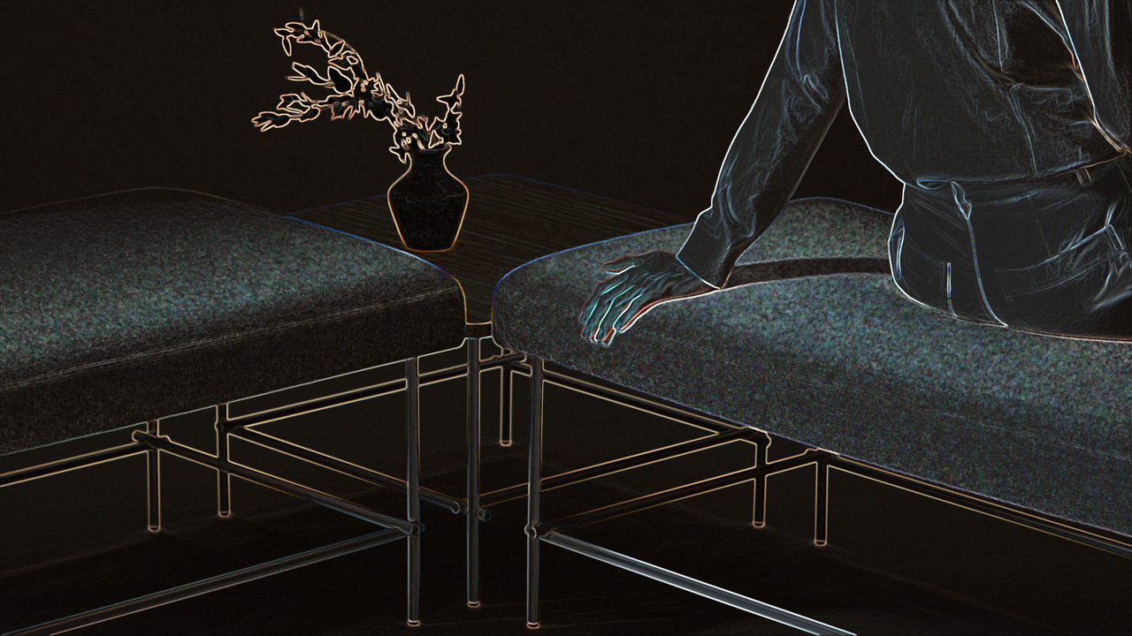
NUC + INCLASS
Design – Perezochando
Notes:
The NUC program comprises a variety of side tables and poufs which combine versatility, style, and contemporary elegance. Each element of the collection is designed to work independently or be freely combined to create unique and functional compositions. The essence of this versatile collection consists of its elegant metal bases, that take their identity from the distinctive knot formed by the crossbars when joining with the legs.
The NUC program offers a wide range of models and formats, from coffee tables to side tables and poufs in different sizes.

Slide 17
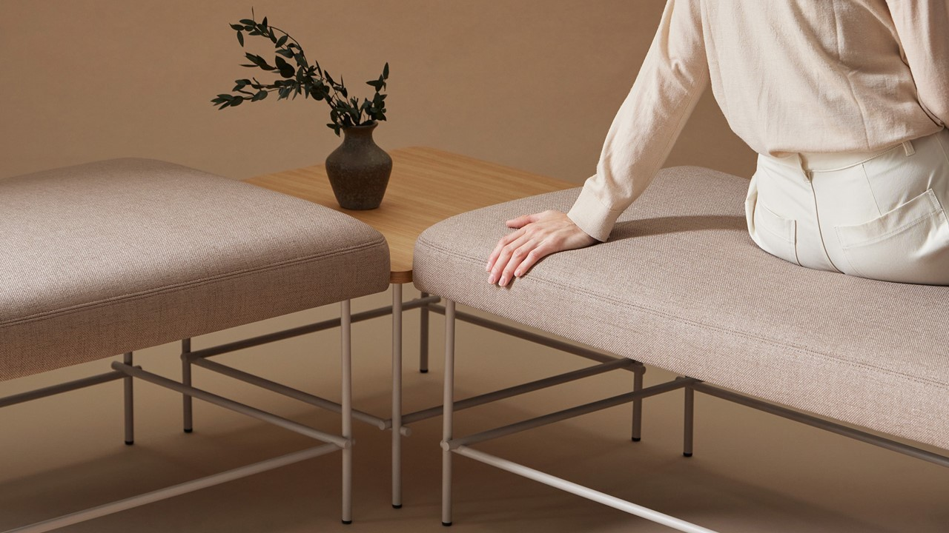
Notes:
NUC means KNOT in Valencian

Slide 18
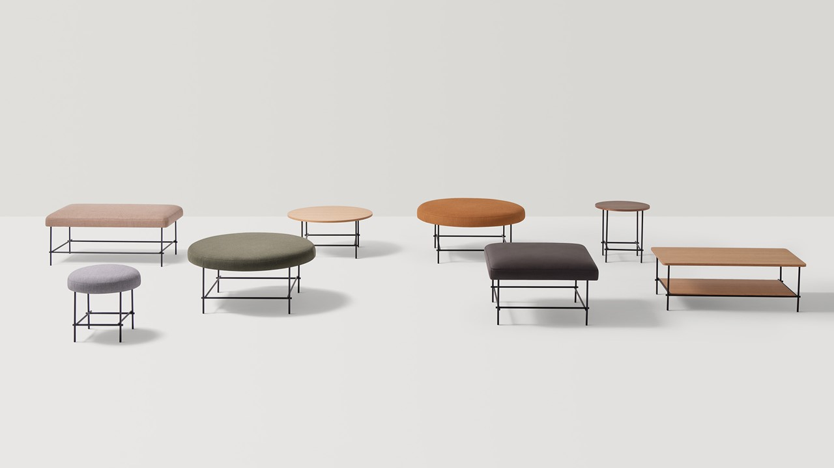
Notes:
POUF/ TABLES:
(round)
19.5 x 19.5”
19.5 x 31.5”
19.5 x 39.5”
(Square)
19.5 x 23.5 x 23.5”
19.5 x 31.5 x 31.5”
19.5 x 15.5 D x 43.5 W
19.5 x 23D x 43.5 W
Side Tables:
20.5 x 19.5
15 x 19.5
15 x 31.5 w
15 x 39.5 w
20.5 x 15.7w
15 x 23.5 x 23.5
15 x 31.5 x 31.5
15H x 23.6D x 43.3W

Slide 19
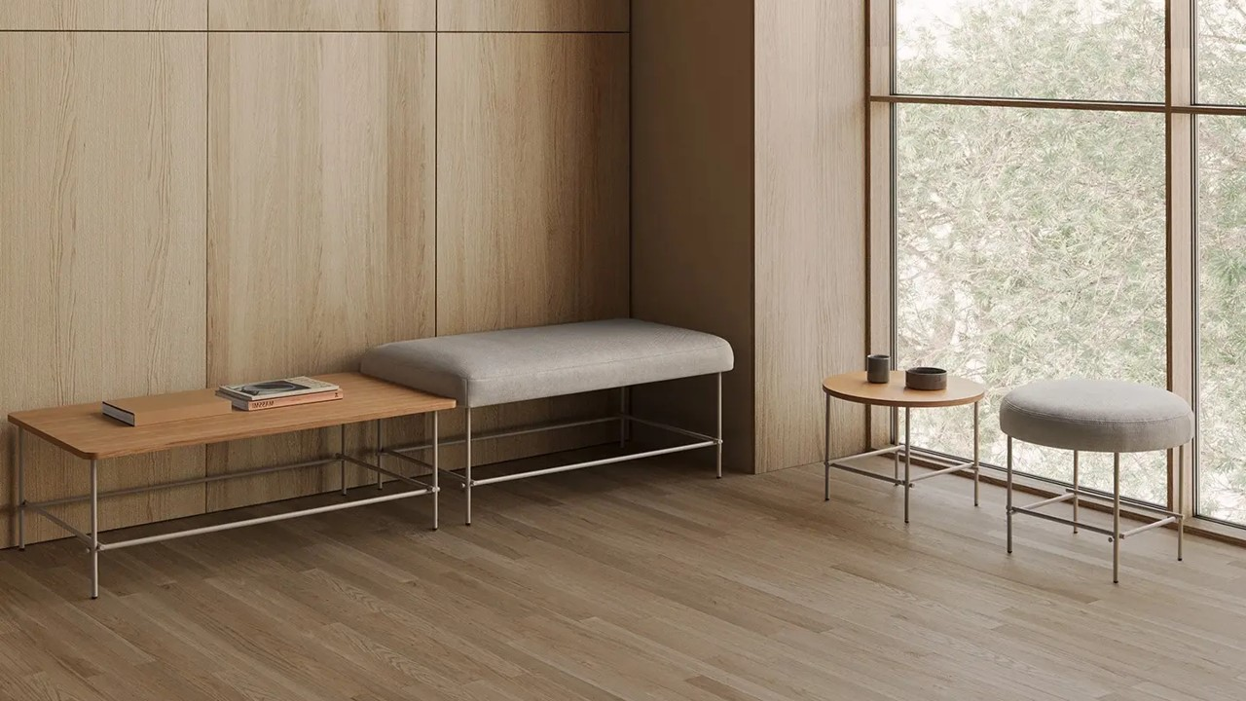
Notes:
NUC means KNOT in Valencian

Slide 20
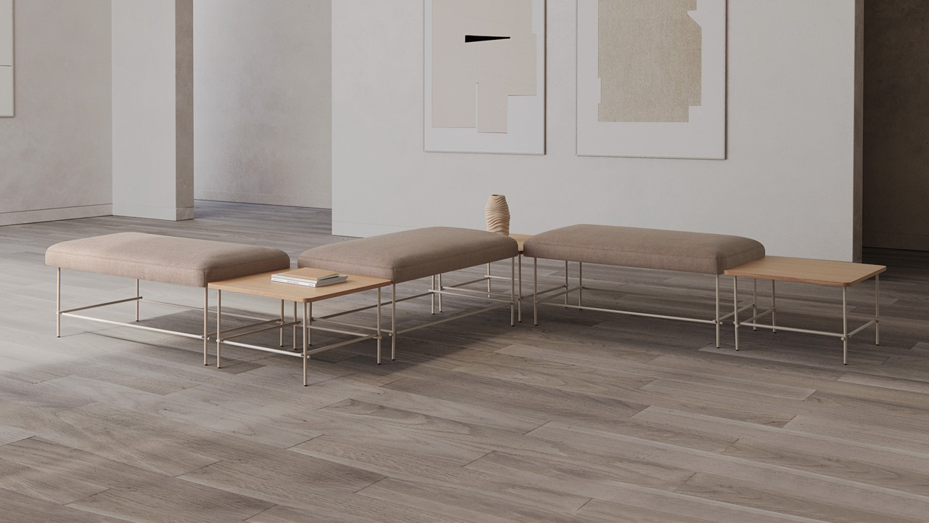

Slide 21
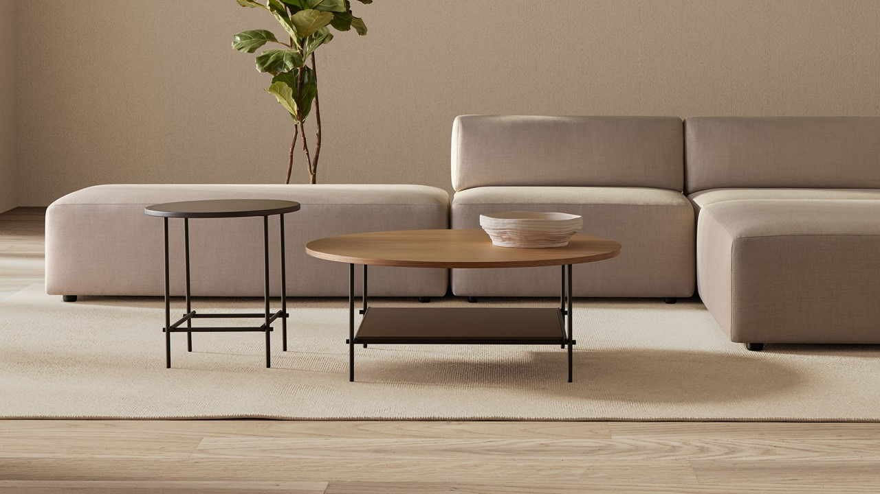

Slide 22
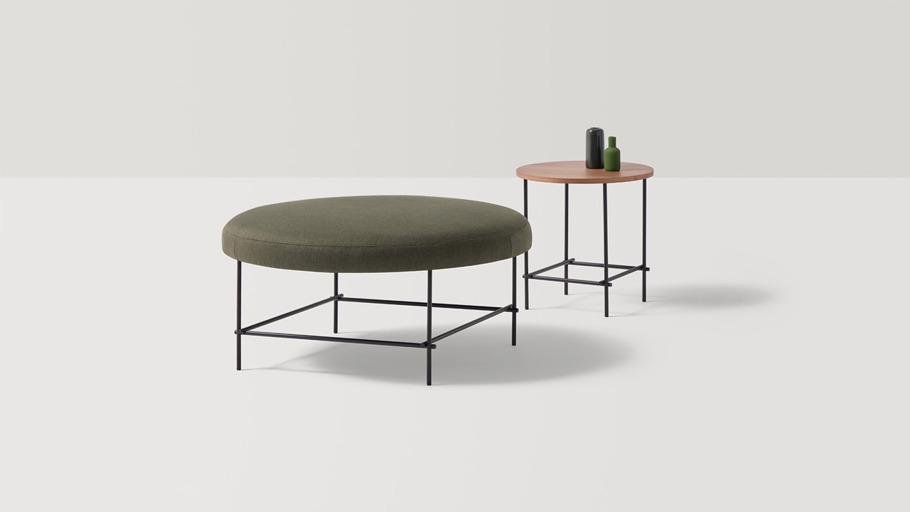

Slide 23
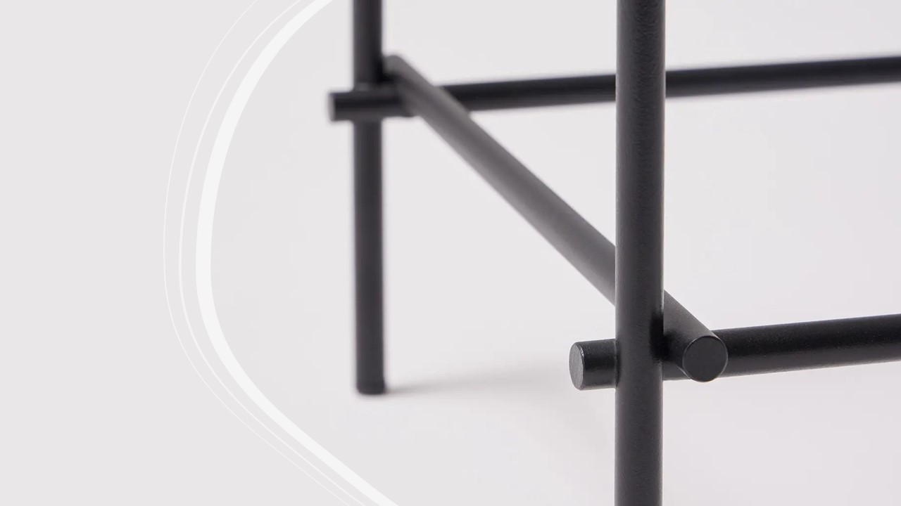

Slide 24
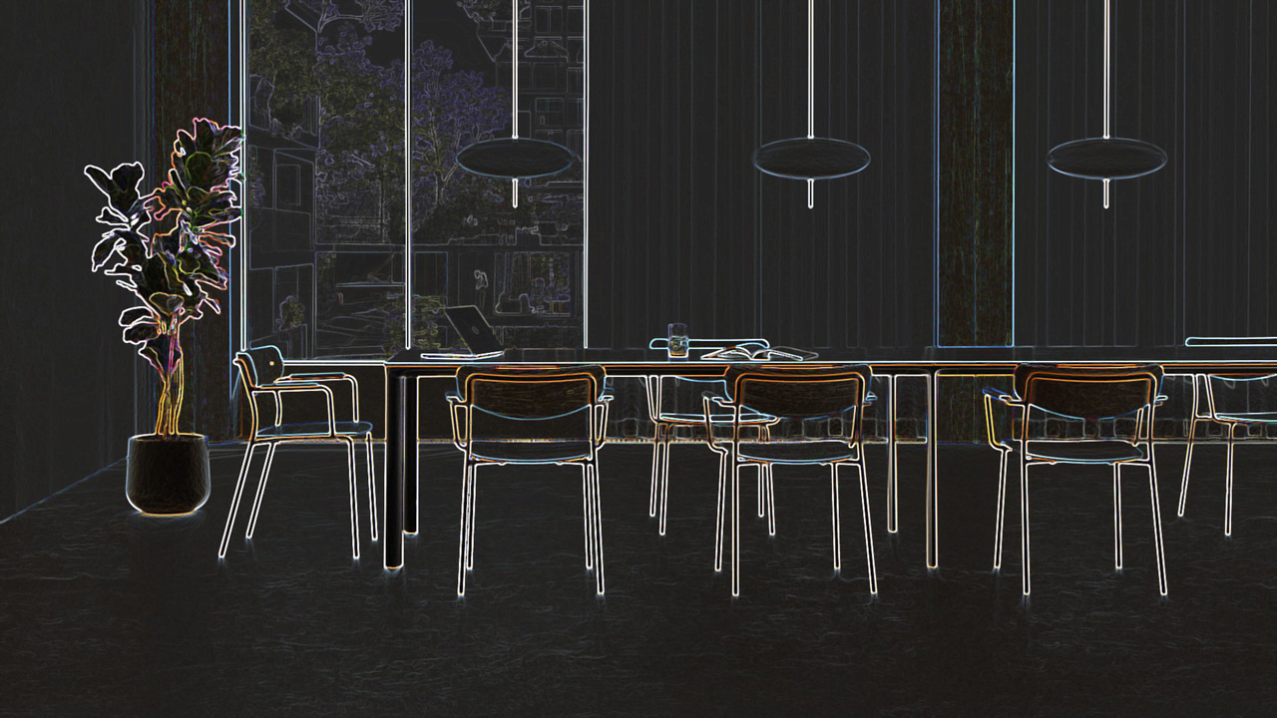
LEA ARMCHAIR + INCLASS
Design - Perezochando

Slide 25
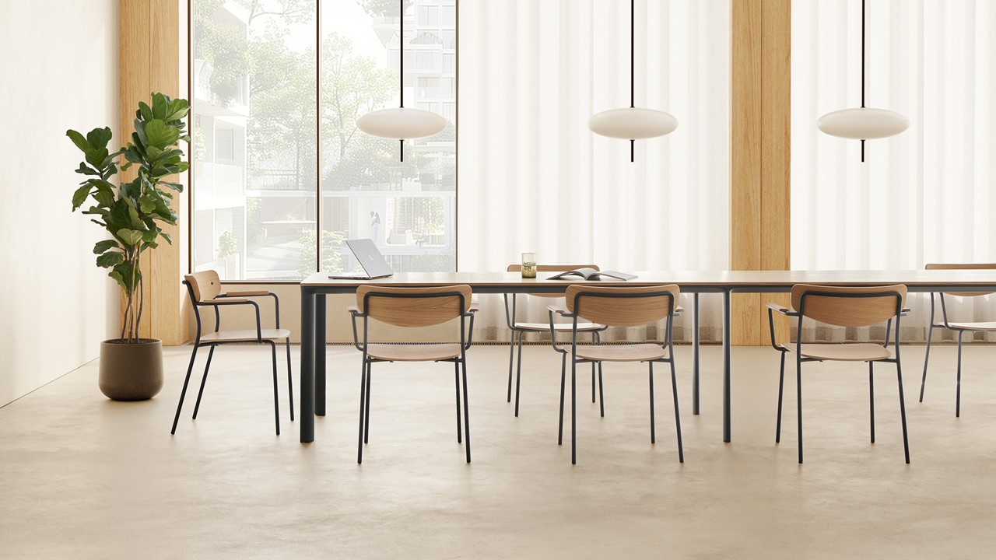
Notes:
LEA is a collection of chairs and stools with an identity marked by a refined and light silhouette that is at the same time strong and unique. The curved shape of the backrest makes it comfortable and recognizable. The family is made up of chairs and stools available in two heights. To achieve greater functionality, both the chairs and the stools are stackable.

Slide 26
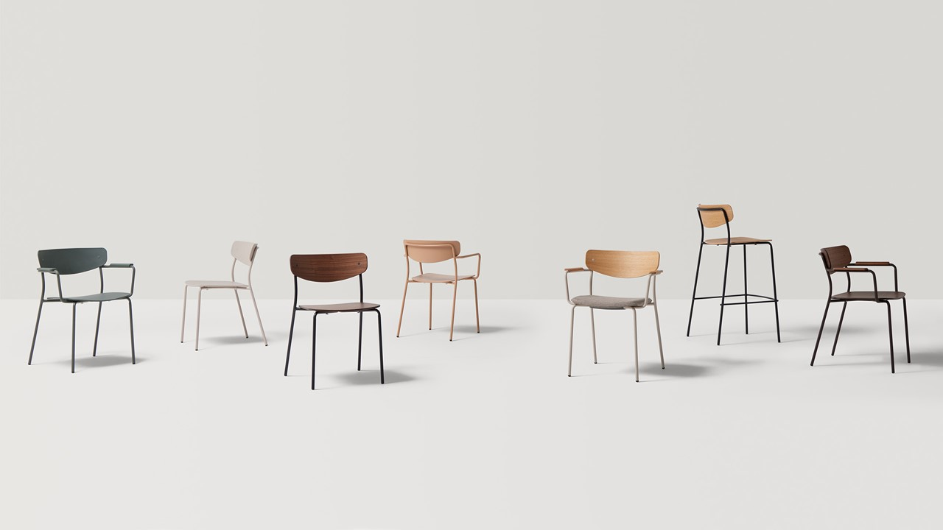
Notes:
Arm chair – available Poly, Wood/ walnut, upholstered.
Stacks 8/ floor 10/ dolly.

Slide 27
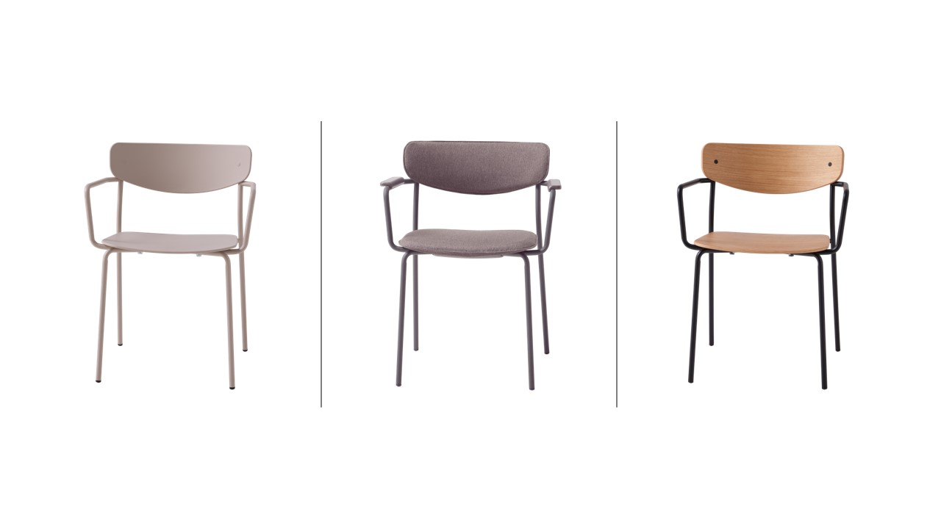
Notes:
Arm chair – available Poly, Wood/ walnut, upholstered.
Stacks 8/ floor 10/ dolly.

Slide 28
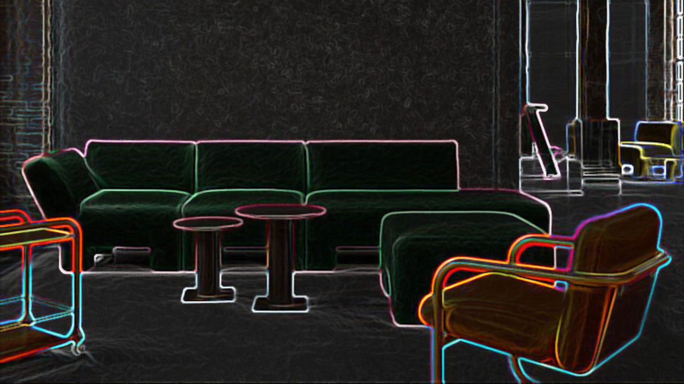
Geofanti + Lammhults
Design – Anya Sebton

Slide 29
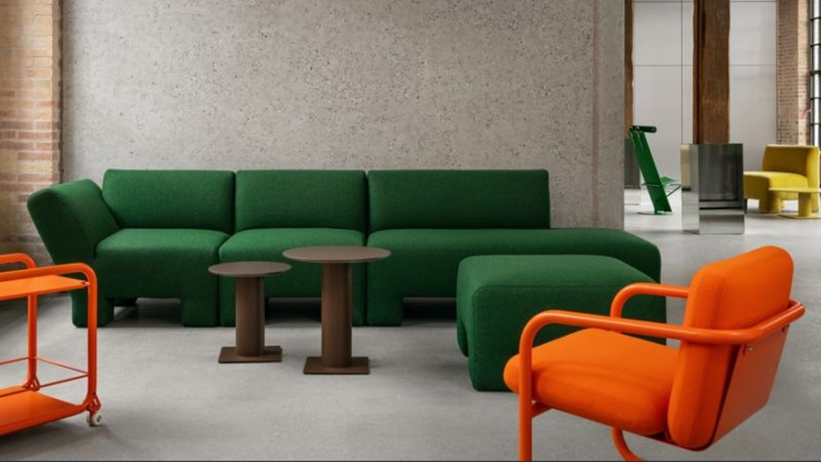
Notes:
The name, Geofanti, celebrates the geometric, modular form while nodding to the qualities it shares with the designer’s favourite animal. The distinctive silhouette resulted from prioritising performance and material circularity in addition to a bold design language.
The upholstery can be fully removed for cleaning, repairs and refreshes, while the extended legs – a set of protective ‘shoes’ are optional – allow for easy cleaning underneath. At the end of its lifespan, Geofanti can be separated into its component parts for recycling. This versatile sofa is suited to an array of environments but will always provide an inviting and cosy spot to rest.

Slide 30
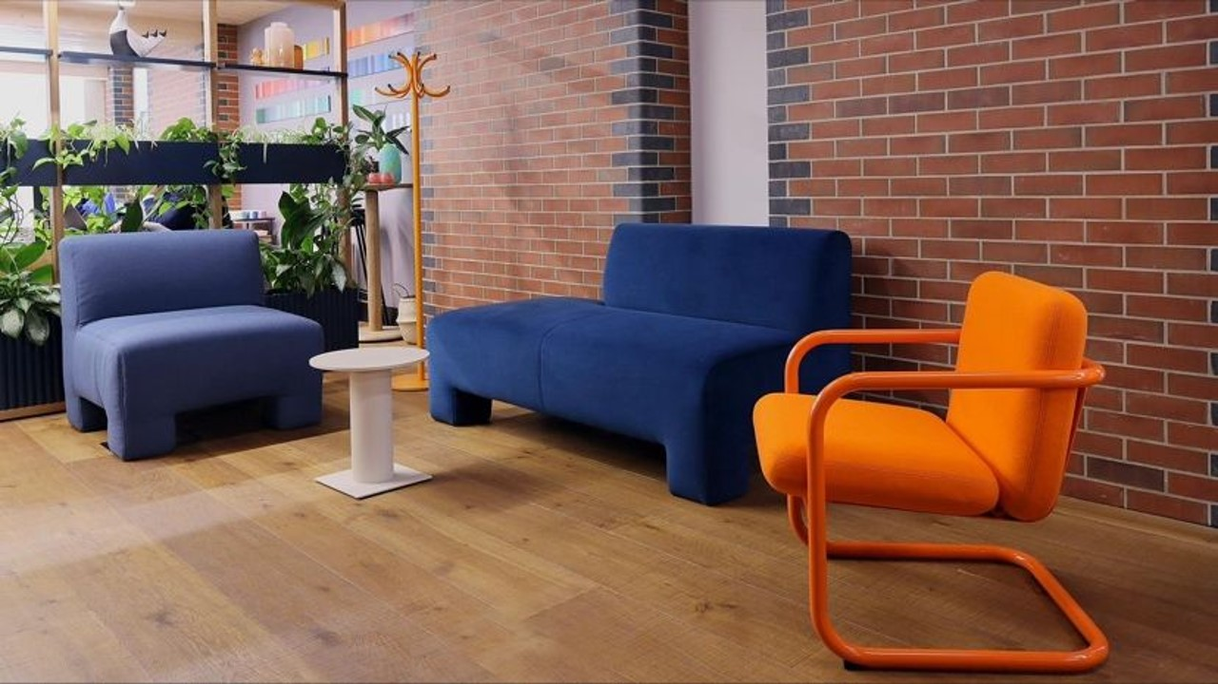

Slide 31
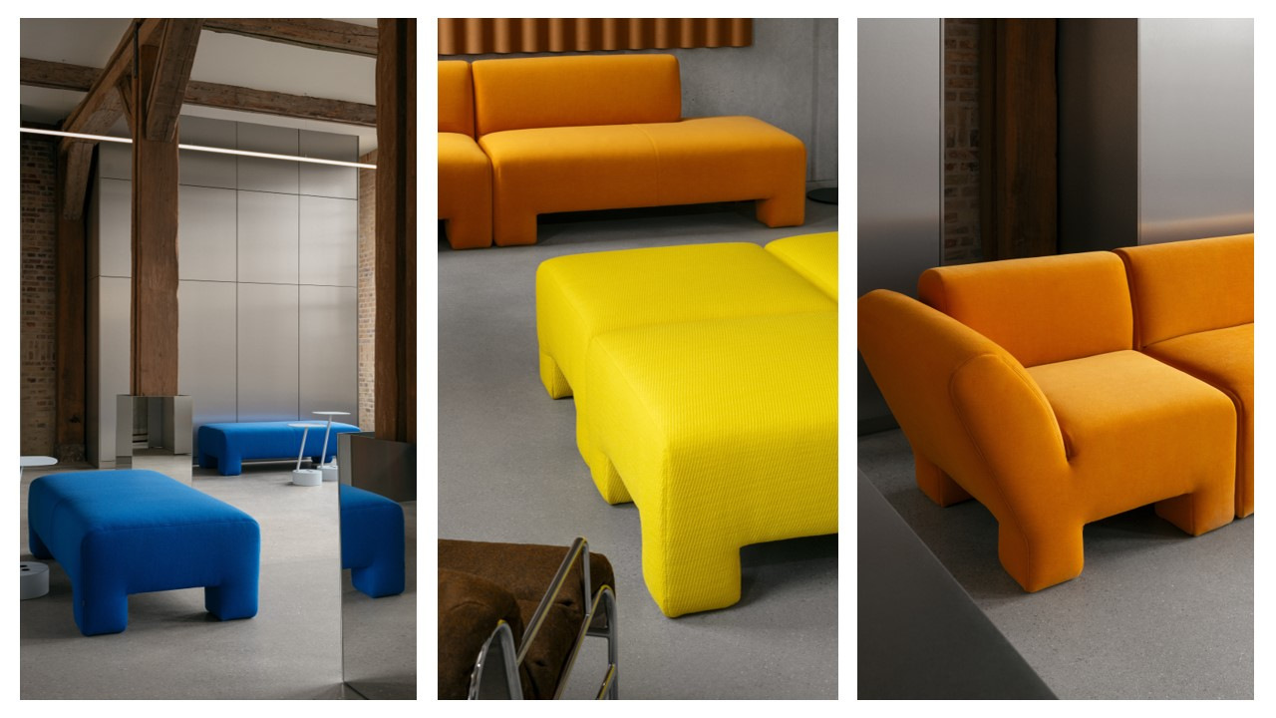

Slide 32
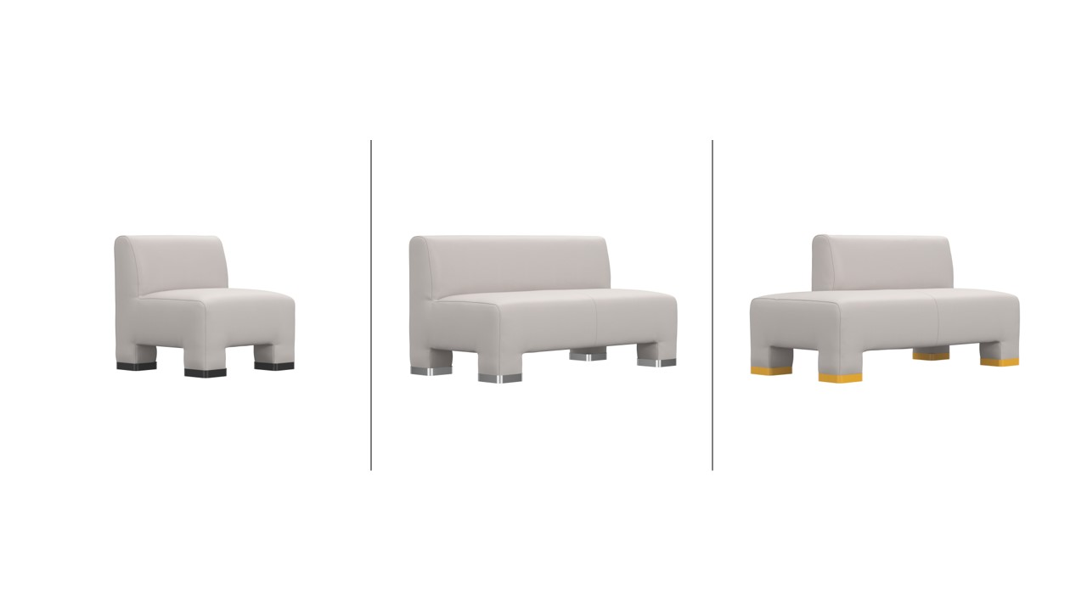
Notes:
Options for Geofanti include “feet” in 14 different colors/ chrome. Also power.

Slide 33
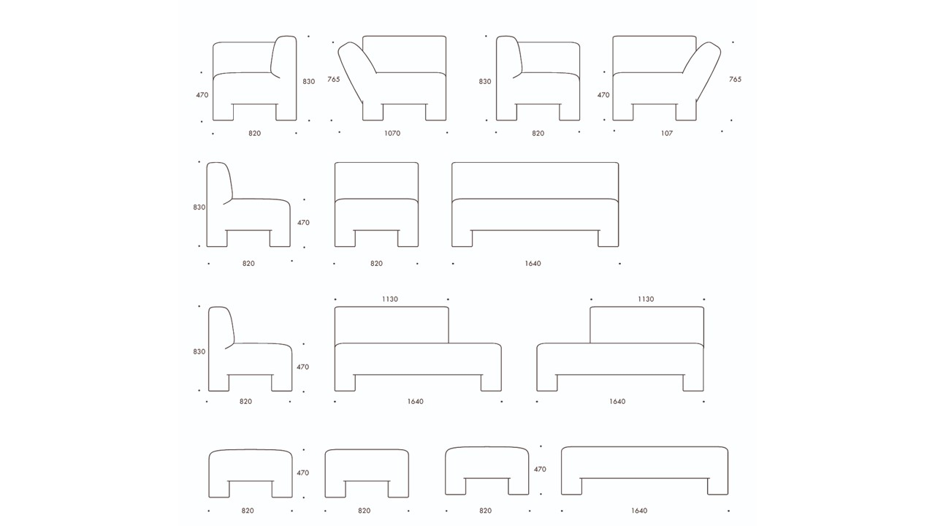

Slide 34
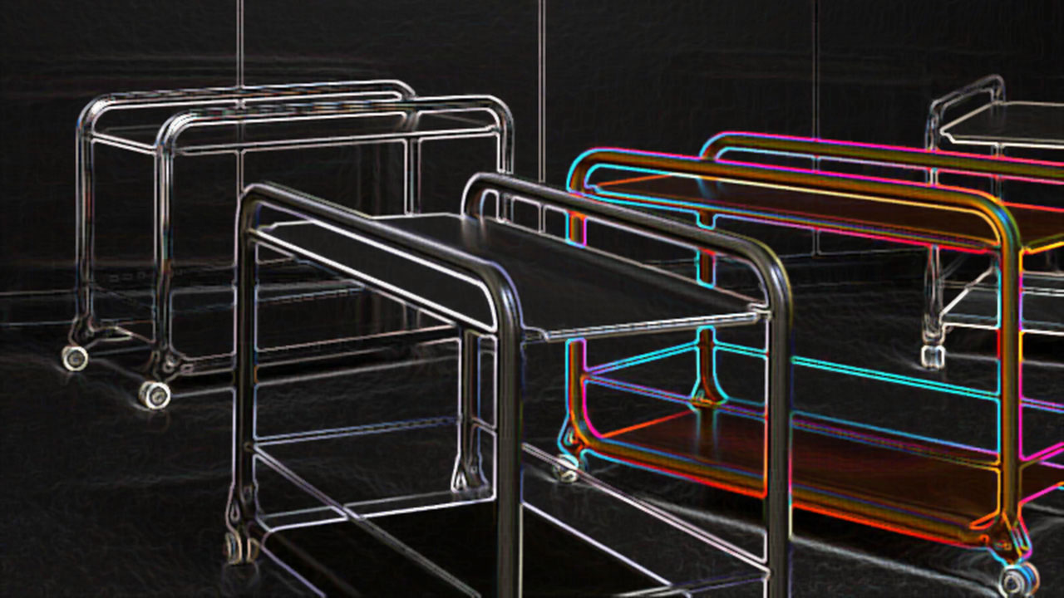
Tension + Lammhults
Design – Gustuv Winsth

Slide 35
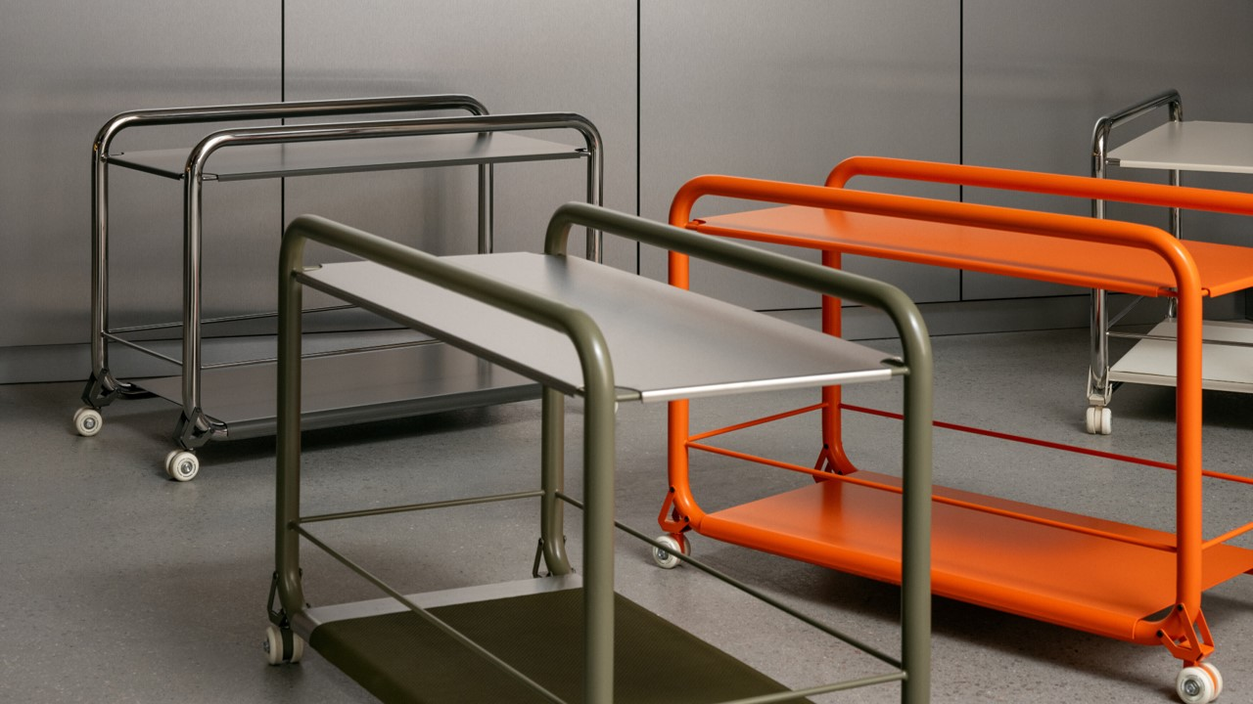
Notes:
Tension is inspired by both the sleek minimalism of today’s personal devices and Lammhults’ bold S70 series from the late 60s. “A trolley is a vehicle, so I made the castors visible and integral to the overall design. Subtly inspired by skate culture, the custom mobility system gives Tension its playful personality.” Featuring a sturdy steel tube frame and ultra-slim shelves, the trolley is a practical addition to any interior — whether used for display, storage or hospitality. With a pared-back welded construction and a broad spectrum of pop colours or sophisticated neutrals to choose from, Tension is a mobile side table — an expression of freedom, even when confined to a quiet corner.

Slide 36
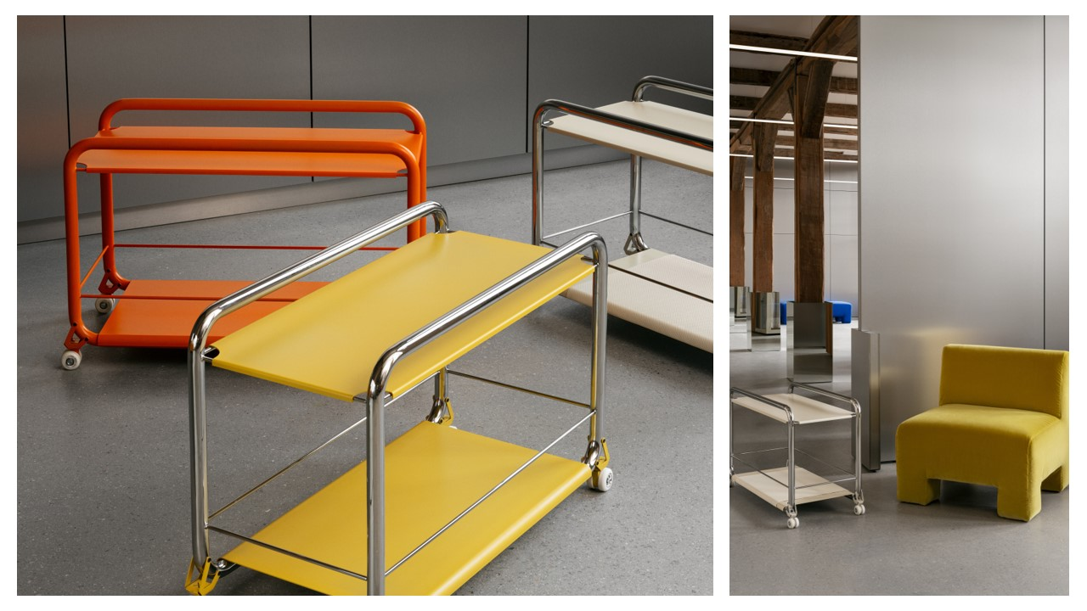
Notes:
Options include steel, leather.

Slide 37
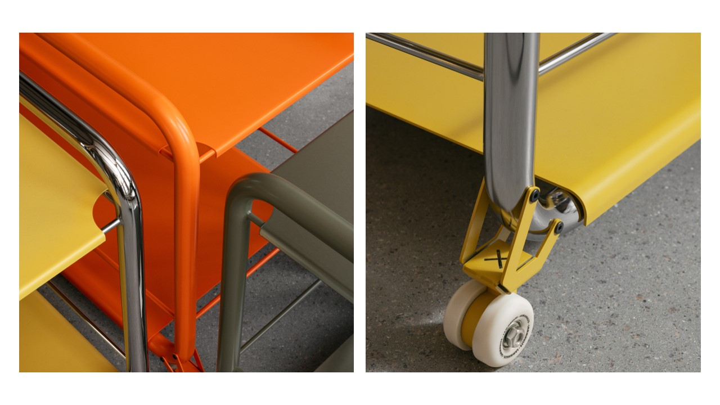

Slide 38
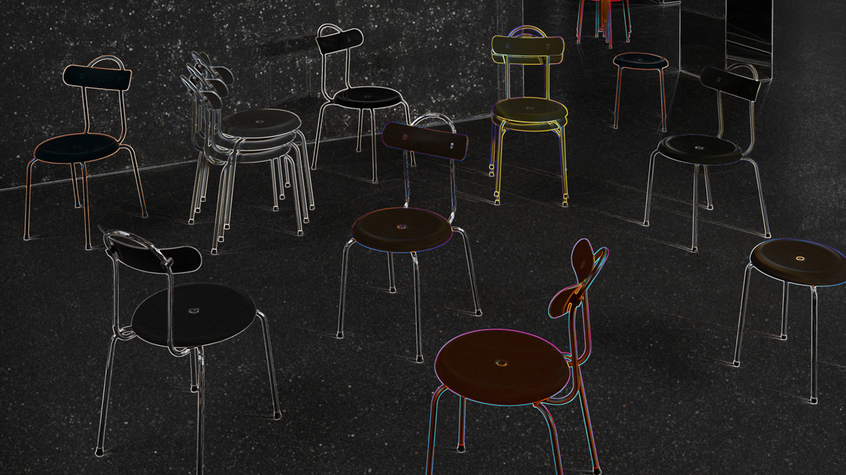
Taburett Plus + Lammhults
Design – Peter Andersson

Slide 39
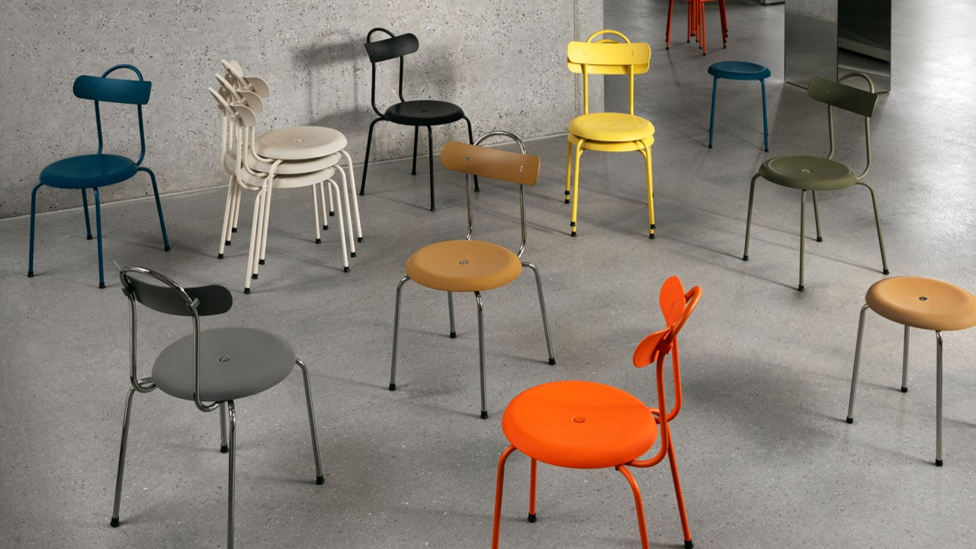
Notes:
Taburett Plus is a homage to the popular 282 stool created by Lammhults founder Edvin Ståhl in 1955 and reissued as Taburett in 2014. Reflecting on the lasting relevance of this piece of Swedish design history, the designer, Peter Andersson imagined a creative conversation with Ståhl as inspiration to extend the iconic design for a contemporary audience. The chairs' seat and back are produced using plastic reclaimed from old refrigerators, while all of the chair’s materials can be separated for future recycling. The backrest references a classic bistro chair, offering a contemporary twist on an informal seating option — complete with a carrying handle for portability and stacking. The seat and back come in 8 different colours to suit any mood or location. For a little extra comfort, the seat is also available in an upholstered option. Taburett Plus is also available for outdoor use, the L-marked button in the seat conceals a drainage hole, ensuring effective rainwater drainage.

Slide 40
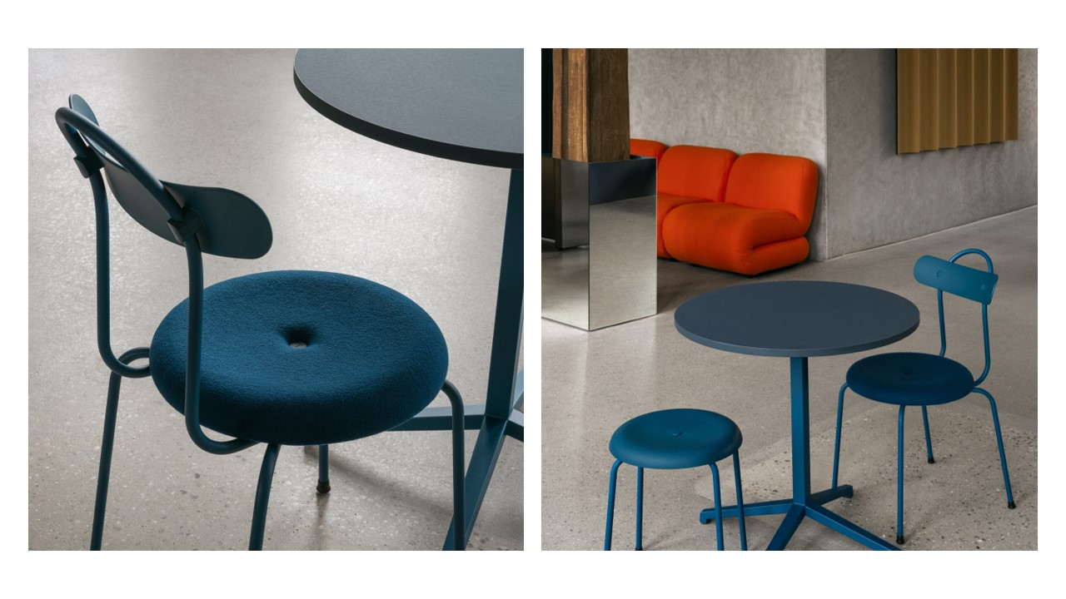

Slide 41
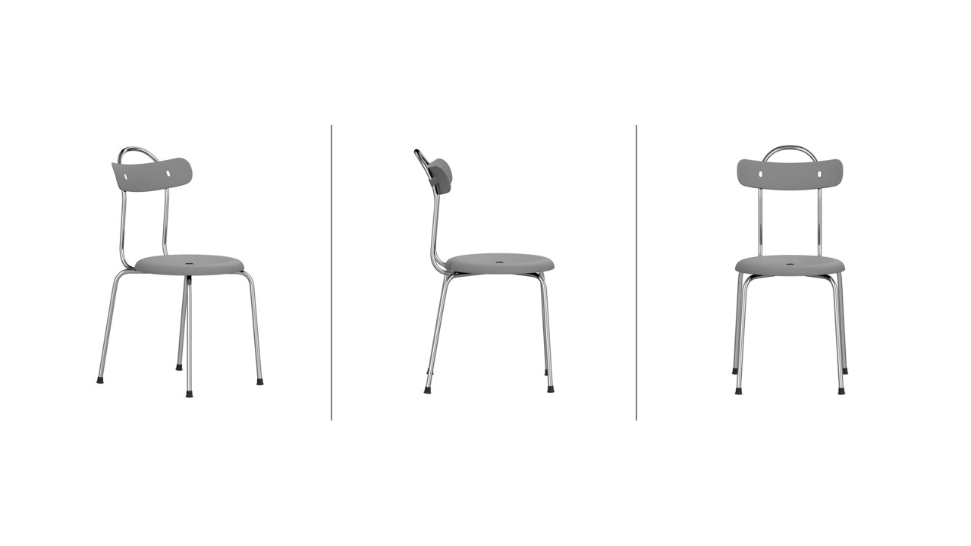

Slide 42
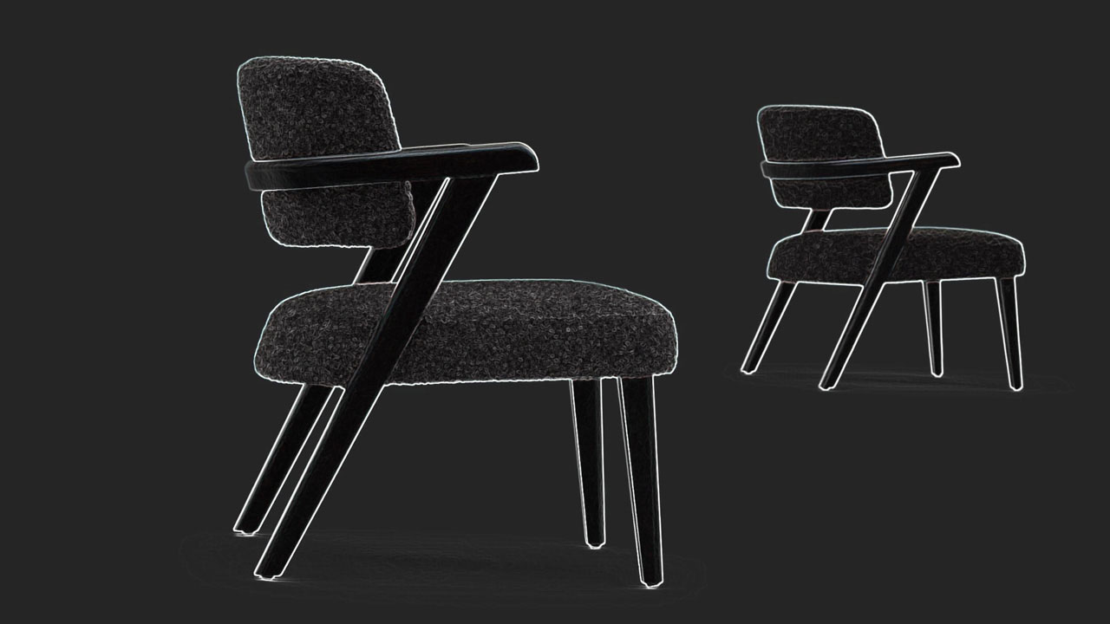
JUMP + MONTBEL
Design – Edi + Paolo Ciani

Slide 43
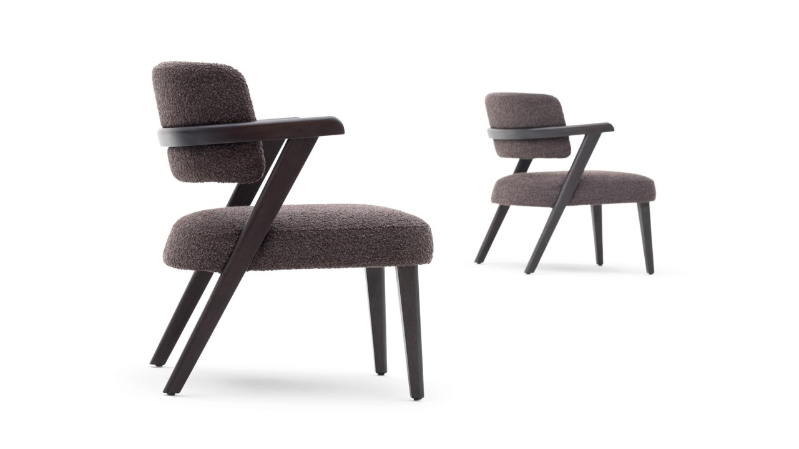
Notes:
Guest/Dining + Lounge armchair, solid wood, curved semi-circular back which blends with the rear legs. Webbed seat with differentiated density padding for greater comfort, wraparound back upholstered in fabric and/or leather as well as the seat.
2.1 – 1990 list (armchair)
5.1 – 2240 list (lounge)

Slide 44
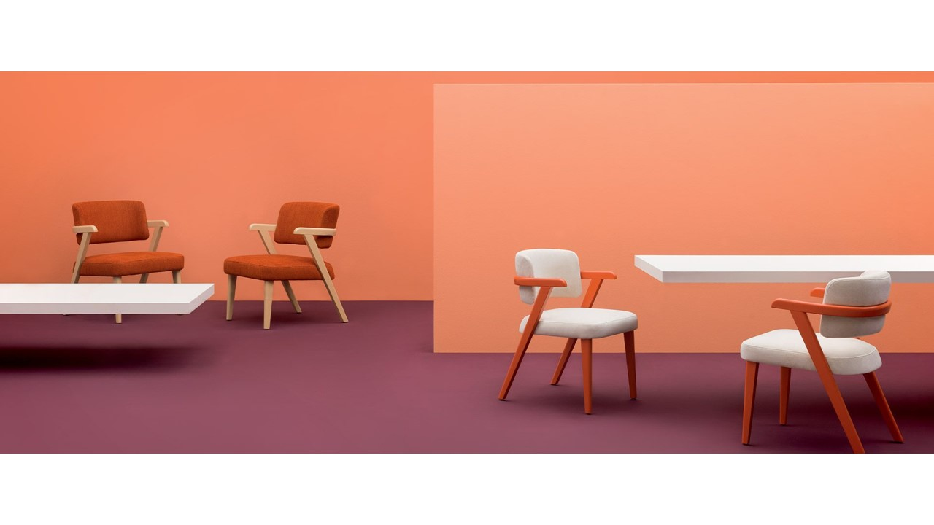

Slide 45
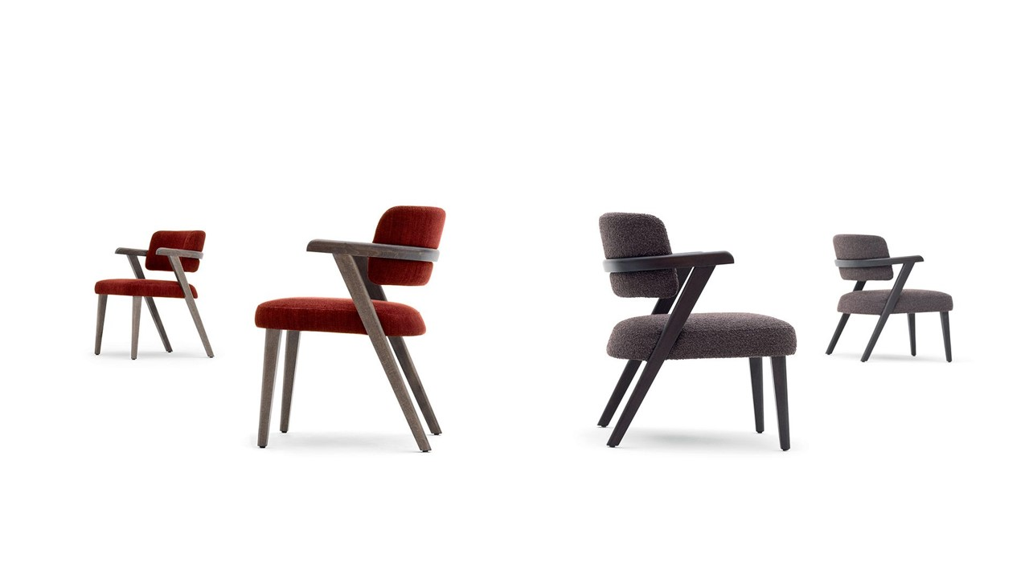

Slide 46
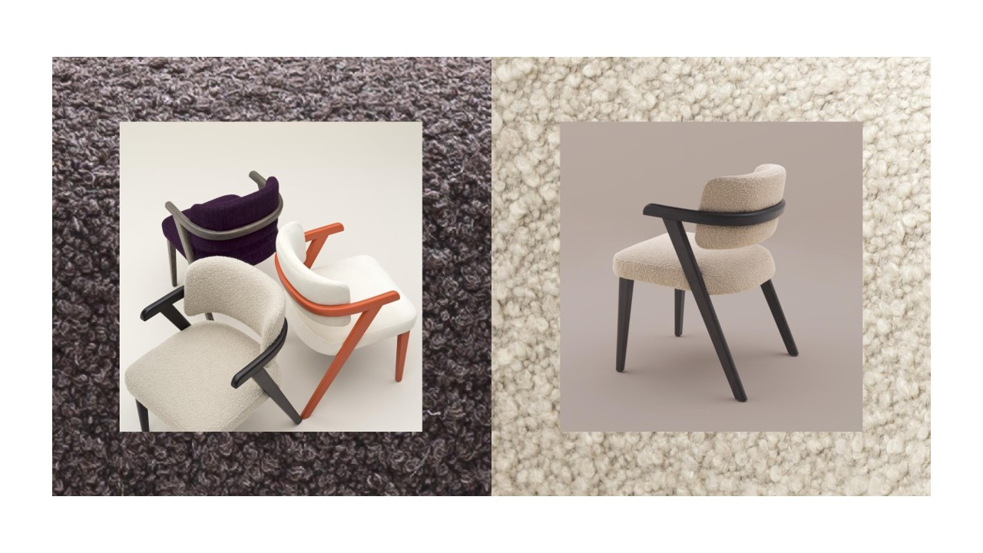

Slide 47
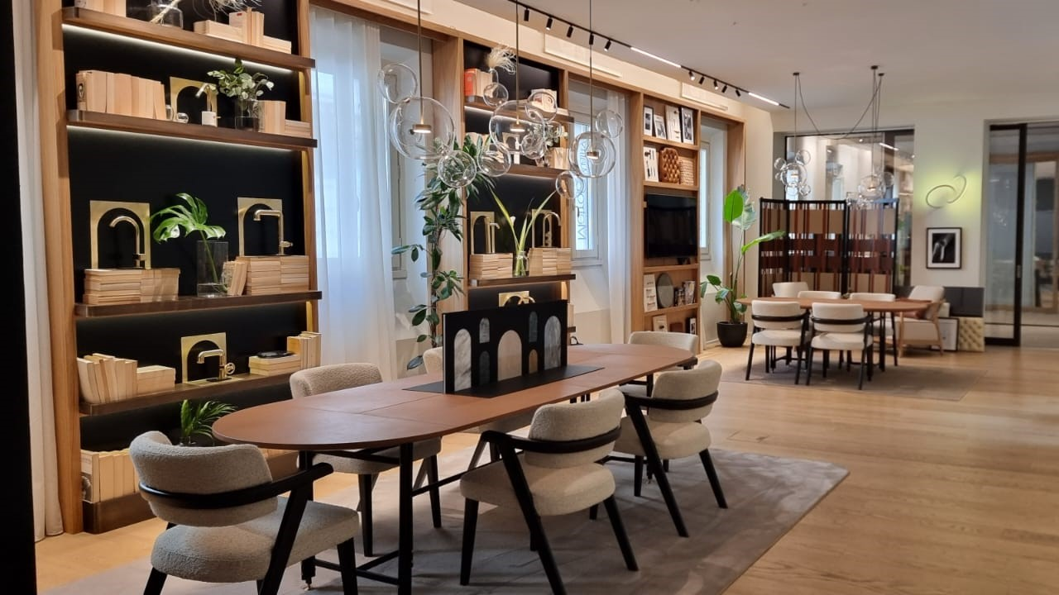

Slide 48
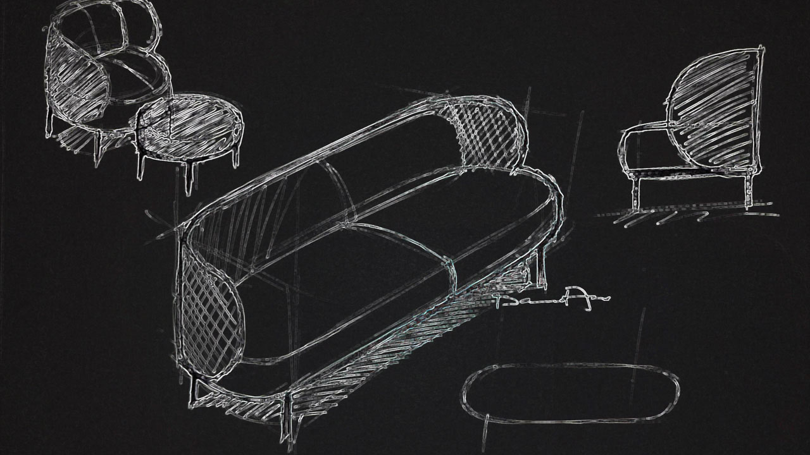
Metiz + Tonon
Design – David Fox

Slide 49
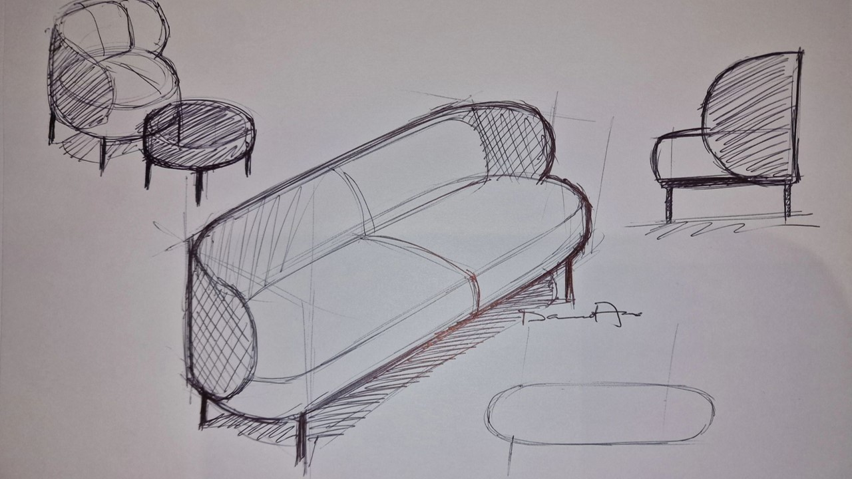
Notes:
Design sketch – showing the family/ range and the inspiration behind the scenes. Metiz family – lounge, dining/ guest, tables.

Slide 50
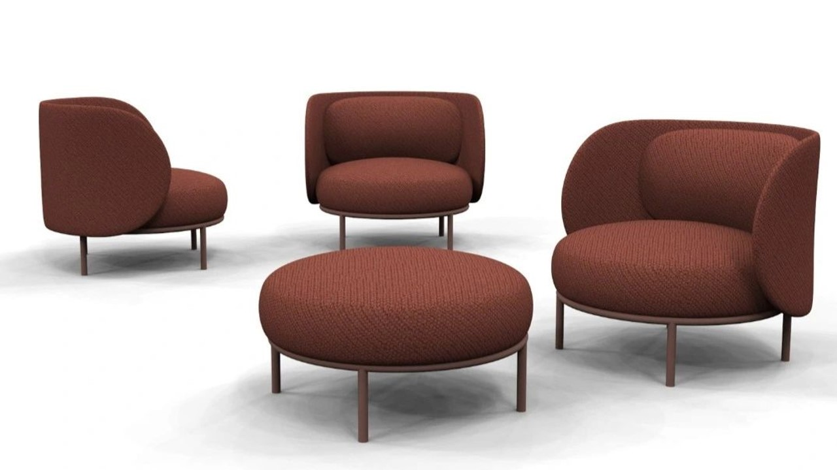
Notes:
Range –
Dining/ Guest 1860 list
Lounge 4590 list
Side table 1480 list

Slide 51
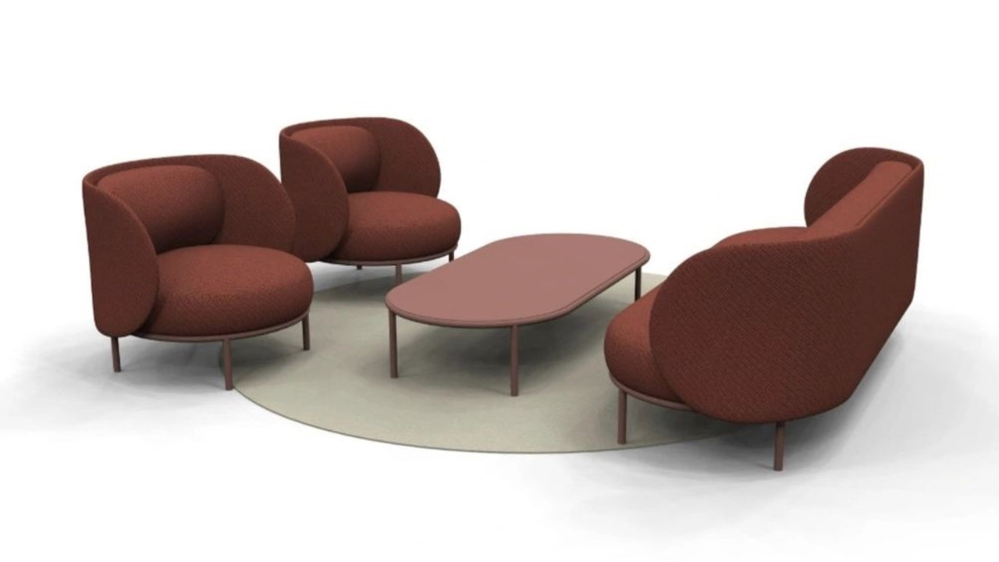

Slide 52
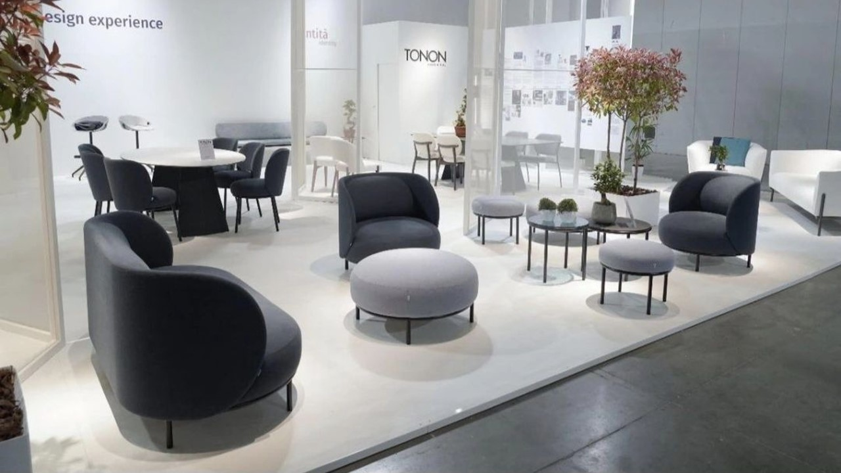

Slide 53
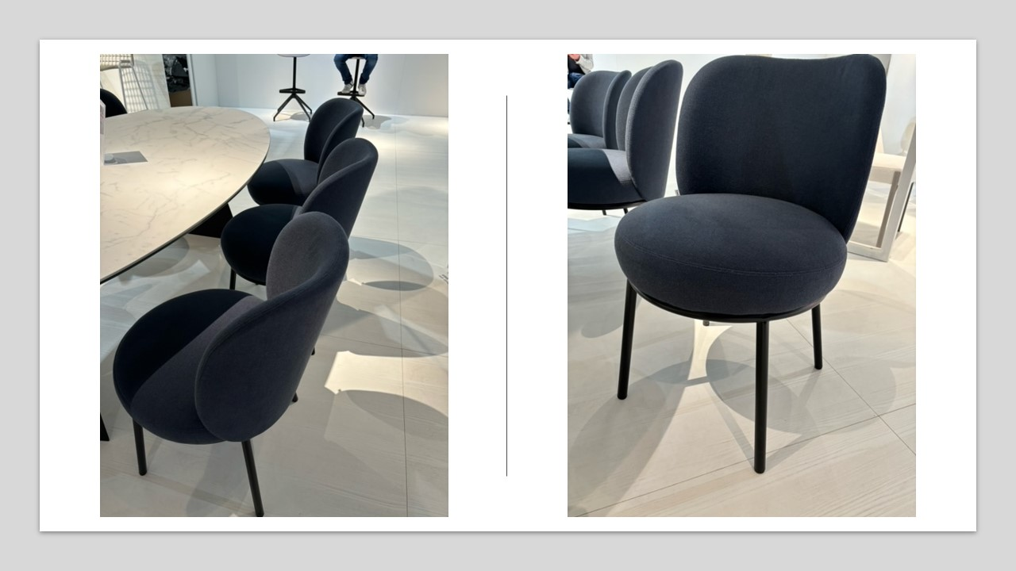

Slide 54
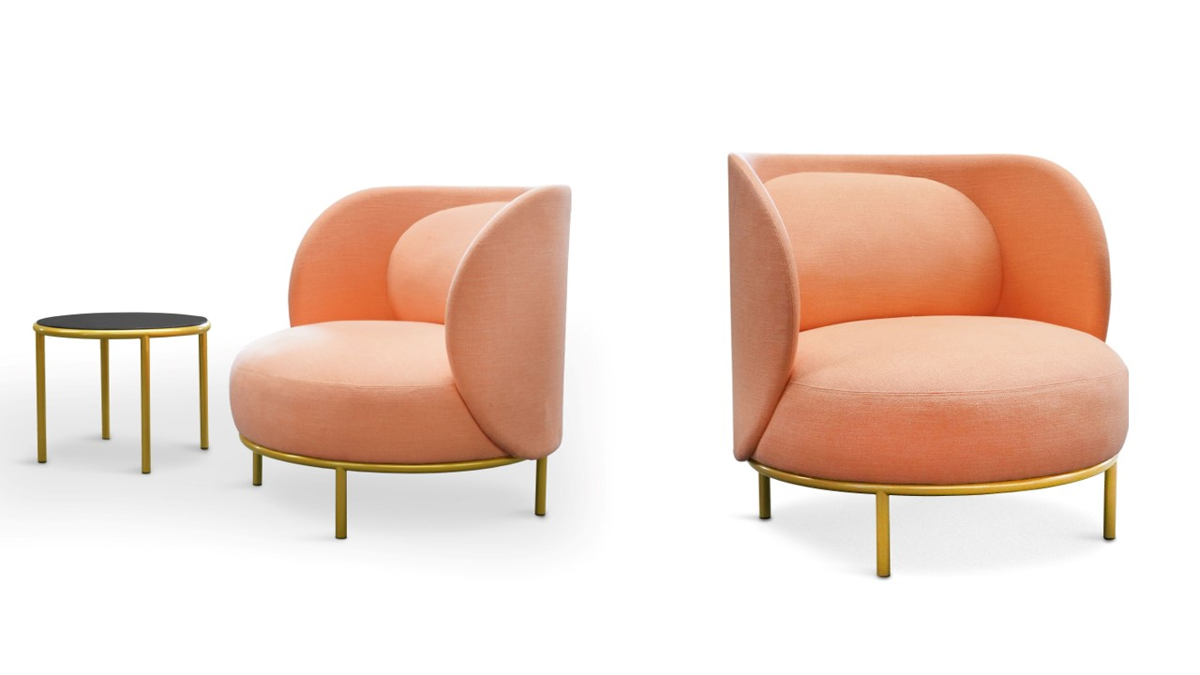

Slide 55
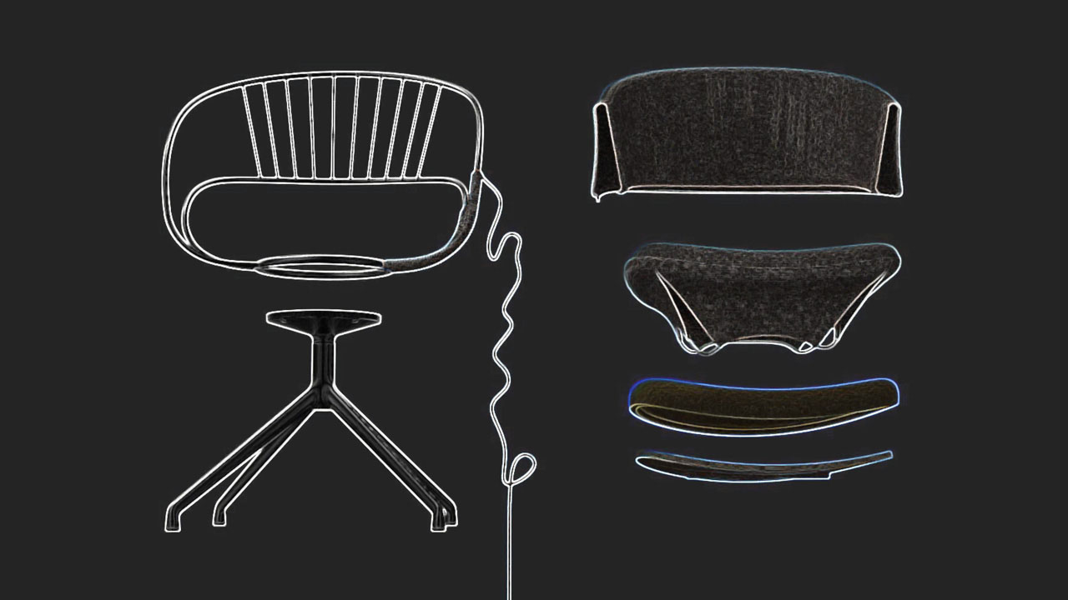
STRIP + TONON
Design – Martin Ballendat

Slide 56
Notes:
Each component was selected based on its recyclability characteristics and used in a project that makes its complete disassembly possible, even for the end user. The name “Strip” was born as an abbreviation of the term “Strip-tease”, which in a playful way wants to underline the possibility of completely stripping the product. The organic shape and the use of innovative polyurethanes with high percentages of recycled raw materials guarantee significant comfort and an optimal sitting position.

Slide 57
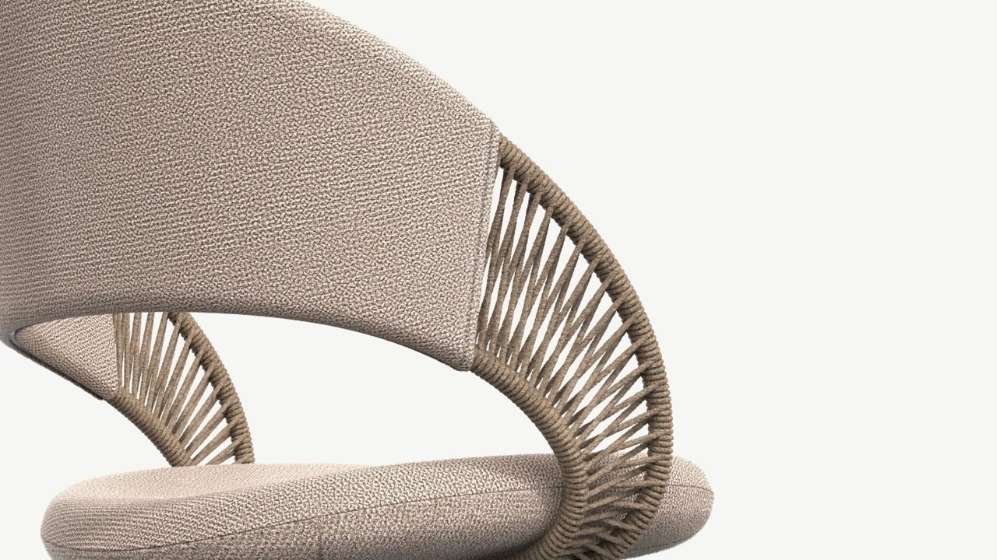
Notes:
Strip”, a collection of seats developed considering the principle of complete separability of materials at the end of the product's life according to circular economy criteria.

Slide 58
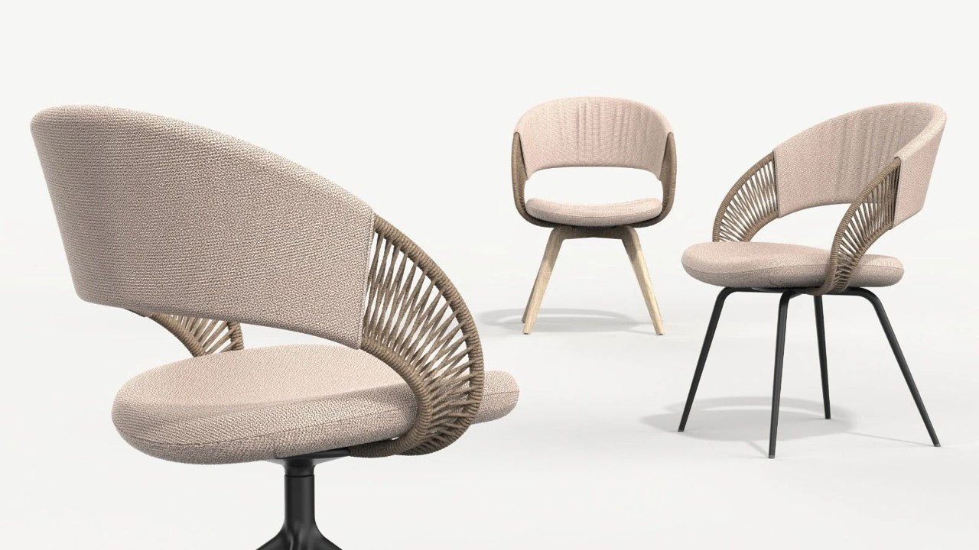

Slide 61
Cosmo + Et Al
Design – Phillipe Tabet

Slide 62
Notes:
Industrial, minimal, overstuffed and inviting lounge w/ accessories.

Slide 63
Notes:
Industrial, minimal, overstuffed and inviting lounge w/ accessories.

Slide 64
Notes:
Accessories add functionality – laptop tables, power, lights, and charging stations.

Slide 65
Notes:
Armchair – bent tubular steel – on trend.

Slide 66
Notes:
Accessories add functionality – laptop tables, power, lights, and charging stations.

Slide 67
Notes:
Accessories add functionality – laptop tables, power, lights, and charging stations.

Slide 68
Notes:
2.15 – 590 List
1.20 – 630 List
1.23 – 560 List

